Slide 1

Annapolis Frogman Swim Kayaker and Swimmer Safety Briefing
Date of Event: April 27, 2025

Slide 2
This is a team event
The safety kayaker and swimmer must act as a cohesive unit!
  Think and function in a manner that honors those we represent.
  Operate, navigate and communicate effectively in all conditions.
  Operate with Rigor and Discipline
Take time to work out individual team plans!
Respect the dynamics of the course and conditions.

Slide 3
Accountability is Non-neg0tiable
Swimmers and kayakers need to read and be familiar with the safety plan before the day of the event.
Swimmers and kayakers check-in pre-race.
Swimmers have swim ticket and chip band.
Kayakers use RaceJoy Real-Time Tracking app on phone. It can be downloaded from the App Store.
Swimmers enter the corral by waves passing over timing mat wearing chip band and also hand in swim ticket.
Once in the corral, DO NOT LEAVE!
Kayakers report to kayak corral and do not leave the beach until their wave is directed to do so.

Slide 4
KAYAKER’S PURPOSE
Safety First
Guide
Communicate

Slide 5
Swimmer preparation
Swimmers and kayakers need to be prepared for the conditions:
Expect the swim to last 1.5 – 3 hours
Swimmers need to wear 5-7mm wetsuits designed for cold open water swimming. Expect temperatures to be between 55° and 60°F
Swimmers should wear two caps or a neoprene hood
Goggles should be worn/Give your kayaker an extra pair
Swimmers may wear fins

Slide 6
Kayaker preparation
Kayaks will be inspected for seaworthiness in open water
Kayaker needs to be dressed for conditions
  Wind resistant clothing
  Wetsuit or drysuit if possible
  Dress for temperature and wind conditions – remember the water will cool the air more than on land
  Sunglasses and sunscreen
Lifejacket must be worn
It is suggested that the kayaker tow a lifeguard belt or swim buoy (Swim buoys may be purchased from crossingcurrentsaquatics.com 443-994-4275)
Expect to be on the water for 1.5 – 3 hours
Bring water for hydration and energy bars for nourishment
We suggest using the restroom before going out on the water

Slide 7
Safety
Know how to:
Prevent and recognize risks
  Hypothermia
  Exhaustion
Intervene
Respond

Slide 8
Safety – Observe your swimmer
Observe your swimmer and pay attention to stroke and breathing rate. Identify any problems early!
Observe if you are on the correct side and position for the swimmer to see you (This should have been discussed pre-swim with the swimmer)
  Are there any changes in stroke or breathing that may indicate they are struggling?
      Hyperventilating or gasping
      Not breathing regularly
      Shivering
      Stopping often
      Not making headway/cramping
      Incoherent when speaking
    Know the signs of Hypothermia

Slide 9
Signs of hypothermia
Shivering /extreme goosebumps/bluish lips are the first sign.
Slurred speech or trouble talking
  Kayakers and buddies will help determine this.
  The person might think they are fine when they are NOT
Fumbling hands. Claw hand where the fingers curl and lock on their own
Difficulty putting fingers together
Confusion/disorientation/feeling woozy
  Someone can’t stay on course.
Exhaustion or feeling very tired or drowsy.
Memory loss/brain fog
A feeling of panic or anxiety
Swimming continuously without taking a breath
**If the kayaker notices their swimmer is exhibiting any of the above signs of hypothermia, the kayaker shall advise the swimmer and signal for a Jet Ski guard to bring the swimmer to the Fire-Rescue boat. Fire-Rescue can then evaluate the swimmer. Fire-Rescue will make the final determination of the swimmer’s ability to continue or if he should be removed from the swim. The decision of Fire-Rescue is final and non-negotiable!

Slide 10
After the Swim
Remember the swimmer is still susceptible to Hyperthermia!
After Drop – A condition caused during initial warming. As blood moves back into cold limbs the core temperature can drop.
Visit the warming tent right after finishing the swim. This will be mandatory.

Slide 11
Remember – Kayakers can become hypothermic also!
Pay attention to your own condition and that of kayakers around you
Prepare for wind
Prepare for cold
Prepare to get wet
Bring a thermos of a hot drink for you and the swimmer

Slide 12
Distress signal
Paddle held up over the kayaker’s head and blow three short blasts on the whistle.
This signals the nearest Fire-Rescue Personnel and jet ski operator that you need assistance. A jet ski operator will then move in to pick up your swimmer.
If in doubt advise the swimmer that you are signaling Fire-Rescue Personnel. Keep the swimmer calm until Fire-Recue arrives to evaluate the swimmer.
Nearby kayakers should also hold their paddles overhead to make distress signal more visible.
Whistle blasts can be repeated periodically if necessary.

Slide 13
Guide
Turn buoys are large red tetrahedrons or yellow cylindrical buoys. We will announce which ones are being used on event day.
    Pass the buoy with it on your left shoulder
Smaller orange and yellow round buoys are guides leading to the next turn buoy.
    Can pass guide buoys on either side.
    Can hang on guide buoys if necessary
Freddie the Frog Buoys signal the midway point and the turn to the finish
Know the course – Triangle, 3.1 miles.
By the kayaker staying on course the swimmer does not have to sight.

Slide 14
Communicate
Communicate Before the Swim
    Where does the swimmer want the kayaker positioned –slightly ahead, along side, which side, etc.
    What kind of hand signals does the swimmer want the kayaker to communicate with.
Talk to your swimmer if he stops.
      Check if he is alright.
      Ask him what day it is.
      Ask him why he is swimming.
      Ask him his number.
  At each turn buoy tell the turn boat your swimmer’s number.
  Know the on the water signals.
      Paddle over the head with 3 short whistle blasts – Distress.
      5 short blasts of the whistle followed by one long blast – Stop swimming/return to shore.
      1 or 2 whistles – Getting the swimmers attention.
  When your swimmer approaches the finish announce his number to the Finish Line Attendants and Volunteers and guide your swimmer to the Finish Line Gate. Take them all the way to shore!

Slide 15
Boats on course
Fire-Rescue Personnel Boats
Professionally trained career EMTs and Paramedics trained for marine rescue
Respond to swimmers in need and removal from course if necessary
Medical attention – Will handle on shore and off-shore communications with first responders
Jet Skis – Ocean Lifeguard trained for ocean rescue. Jet skis do not have a prop and can be used to get close to swimmers if necessary.
Volunteer Motor Boats– Anchored at turn buoys for recording the number of each swimmer rounding the turn buoy. Responsible to watch for kayaker distress signals and alert Fire-Rescue over the radio when you see or hear a distress signal.
Volunteer Motor Boats – Present to set up and dismantle the course. During the swim they will remain anchored inside the triangular course and watch for kayaker/swimmer distress signals. When you see a distress signal, alert the Fire-Rescue personnel over the radio.

Slide 16
Communication on the water
Fire-Rescue will assign a channel for motor boat operators to monitor. All volunteer boat operators will be advised of the channel.
Motor boat operators shall radio Fire-Rescue upon seeing or hearing kayaker distress signals.
Fire-Rescue will facilitate any communication with on shore and off-shore first responders.
Kayakers will communicate with hand/paddle signals and whistles blasts
Communication between the event organizers shall be by VHF radio and long range walkie-talkies. Cell phones will be used as a backup.
Back-up system: Cell Phones
Walkie-Talkies: Channel to be provided
  Fire-Rescue: TBD
  Chris Swensen: 410-693-2500 (Main In-Water Event Coordinator)
  Frank Larkin: 443-852-2390 (Fire-Rescue Liaison)
  Dave Priddy: 240-508-4629 (Back-Up)

Slide 17
Communication Check
Communication Check at 8:20 AM between Frank Larkin (at the start/finish), each of the volunteer motor boats, and Fire-Rescue Personnel.

Slide 18
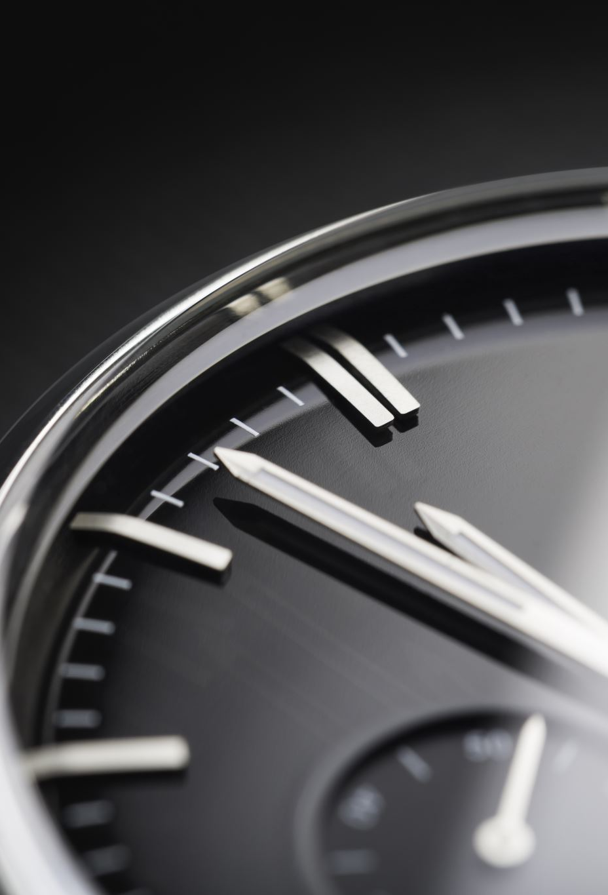
Additional Information
Water and air Temperature on the day of the swim.
  Water expected to be 57 – 60 Degrees F.
  Air expected to be 40 – 80 Degrees F.
The tide will be rising less than 1 foot during the swim.
  High at 4:48 AM and 5:10 PM
  Low at 11:48 AM (1148)

