Slide 1

Annapolis Frogman Swim swimmer and kayaker Safety Briefing
Date of Event: April 26, 2026

Slide 2
KAYAKER’S PURPOSE
Safety First
Guide
Communicate

Slide 3
Swimmer preparation
Swimmers and kayakers need to be prepared for the conditions:
Expect the swim to last 1.5 – 3 hours in 55℉ to 60℉ water temperature
Swimmers need to wear 5-7mm wetsuits designed for open water swimming
Swimmers should wear two caps or a neoprene hood
Goggles should be worn/Give your kayaker an extra pair
Swimmers may wear fins and a swim buoy
Know the course you will be swimming

Slide 4
Kayaker preparation
Kayaks will be inspected for seaworthiness in open water
Kayaker needs to be dressed for conditions
  Wind resistant clothing
  Wetsuit or drysuit if possible
  Dress for temperature and wind conditions – remember the water will cool the air more than on land
  Sunglasses and sunscreen
Lifejacket must be worn
It is suggested that the kayaker tow a lifeguard belt or swim buoy
Expect to be on the water for 1.5 – 3 hours
Bring water for hydration and energy bars for nourishment
We suggest using the restroom before going out on the water

Slide 5
Swimmer/kayaker Prep
Know the course and any alternative courses that may be used.
Preview on the website – www.annapolisfrogman.com
Read the Event Summary (also on the website)
Check charts posted at the event site on the day of the event
  At registration
  On the beach

Slide 6
Safety – Observe your swimmer
Observe your swimmer and pay attention to stroke and breathing rate.
Observe if you are on the correct side and position for the swimmer to see you (This should have been discussed pre-swim with the swimmer)
  Are there any changes in stroke or breathing that may indicate they are struggling?
      Hyperventilating or gasping
      Not breathing regularly
      Stopping often
      Not making headway.
      Incoherent when speaking
    Know the signs of Hypothermia

Slide 7
Signs of hypothermia
Shivering /extreme goosebumps/bluish lips are the first sign.
Slurred speech or trouble talking
  Kayakers and buddies will help determine this.
  The person might think they are fine when they are NOT
Fumbling hands. Claw hand where the fingers curl and lock on their own
Difficulty putting fingers together
Confusion/disorientation/feeling woozy
  Someone can’t stay on course.
Exhaustion or feeling very tired or drowsy.
Memory loss/brain fog
A feeling of panic or anxiety
Swimming continuously without taking a breath
**If the kayaker notices their swimmer is exhibiting the above signs of hypothermia, the kayaker shall advise the swimmer and signal for a Jet Ski guard to bring the swimmer to the Fire-Rescue boat. Fire-Rescue can then evaluate the swimmer. Fire-Rescue will make the final determination of the swimmer’s ability to continue or if he should be removed from the swim.

Slide 8
Remember – Kayakers can become hypothermic also!
Pay attention to your own condition and that of kayakers around you
Prepare for wind
Prepare for cold
Prepare to get wet
Along with water you may want to bring a thermos of a hot drink

Slide 9
Distress signal
Paddle held up over the kayaker’s head and blow three short blasts on the whistle.
This signals the nearest Fire-Rescue Personnel and jet ski operator that you need assistance. A jet ski operator will then move in to pick up your swimmer.
If in doubt advise the swimmer that you are signaling Fire-Rescue Personnel. Keep the swimmer calm until Fire-Recue arrives to evaluate the swimmer.
Nearby kayakers should also hold their paddles overhead to make distress signal more visible.
Whistle blasts can be repeated periodically if necessary.

Slide 10
Guide
Turn buoys are large tetrahedron buoys.
    Pass the turn buoy with it on your left shoulder
Smaller orange and yellow round or cylindrical buoys are guides leading to the next turn buoy.
    Can pass guide buoys on either side.
    Can hang on guide buoys if necessary
Freddie the Frog Buoys signal the turn to the finish
Know the course – Triangle, 3.1 miles. Will swim in a clockwise direction.
By the kayaker staying on course the swimmer does not have to sight.

Slide 11
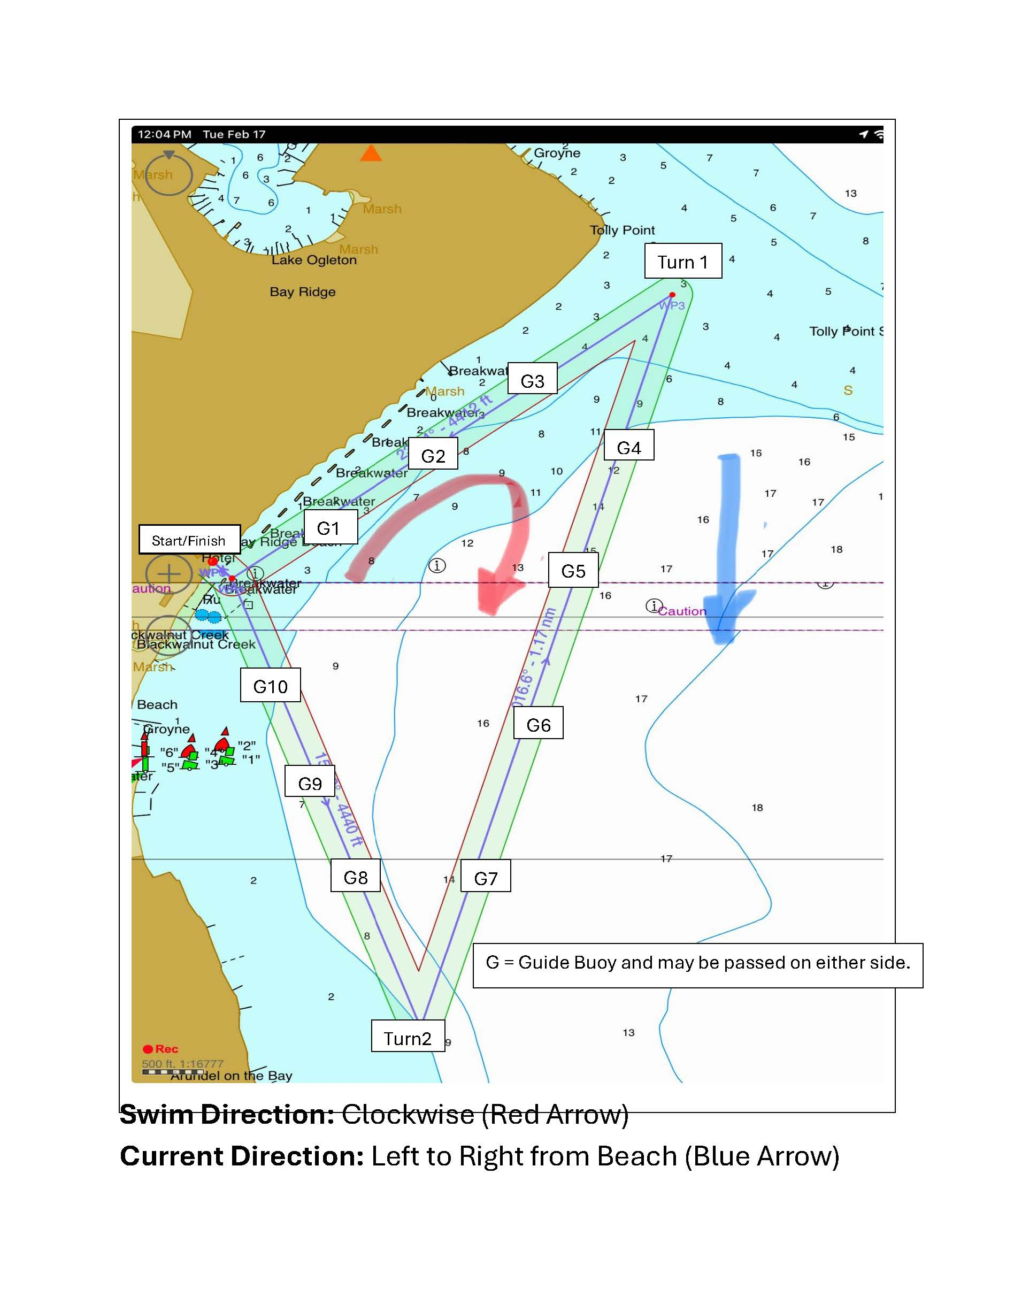
Course Swim Direction: Clockwise (Red Arrow)
Current Direction: Left to Right (Blue Arrow)

Slide 12
Communicate
Communicate Before the Swim
    Where does the swimmer want the kayaker positioned –slightly ahead, along side, which side, etc.
    What kind of hand signals does the swimmer want the kayaker to communicate with.
Talk to your swimmer if he stops.
      Check if he is alright.
      Ask him what day it is.
      Ask him why he is swimming.
      Ask him his number.
  At each turn buoy tell the turn boat your swimmer’s number.
  Know the on the water signals.
      Paddle over the head with 3 short whistle blasts – Distress.
      5 short blasts of the whistle followed by one long blast – Stop swimming/return to shore.
      1 or 2 whistles – Getting the swimmers attention.
  When your swimmer comes to the finish announce his number to the volunteers on shore.
    Guide the swimmer to shore

Slide 13
Boats on course
Fire-Rescue Personnel Boats
Professionally trained career EMTs and Paramedics trained for marine rescue
Respond to swimmers in need and removal from course if necessary
Medical attention – Will handle on shore and off-shore communications with first responders
Jet Skis – Ocean Lifeguard trained for ocean rescue. Jet skis do not have a prop and can be used to get close to swimmers if necessary.
Volunteer Motorboats– Anchored at turn buoys for recording the number of each swimmer rounding the turn buoy. Responsible to watch for kayaker distress signals and alert Fire-Rescue over the radio when you see or hear a distress signal.
Volunteer Motorboats – Present to set up and dismantle the course. During the swim they will remain anchored inside the triangular course and watch for kayaker/swimmer distress signals. When you see a distress signal, alert the Fire-Rescue personnel over the radio.

Slide 14
Communication on the water
Fire-Rescue will assign a channel for motorboat operators to monitor. All volunteer boat operators will be advised of the channel when walkie talkies are handed out. The channel will also be posted on the Support Boat/Jet Ski GroupMe (The GroupMe is only for safety boat and jet ski personnel)
Motorboat operators shall radio Fire-Rescue upon seeing or hearing kayaker distress signals.
Fire-Rescue will facilitate any communication with on shore and off-shore first responders.
Kayakers will communicate with hand/paddle signals and whistles blasts.
Communication between the event organizers shall be by VHF radio and long-range walkie-talkies.
Back-up system: Cell Phones
Walkie-Talkies: Monitoring channel to be provided when walkie talkies are handed out.
  Fire-Rescue: TBD
  Chris Swensen: 410-693-2500 (Main In-Water Event Coordinator)
  Dave Priddy: 240-508-4629 (Back-Up)

Slide 15
Communication Check
Communication Check at 8:20 AM between Frank Larkin (at the start/finish), each of the volunteer motorboats, jet skis and Fire-Rescue Personnel.

Slide 16
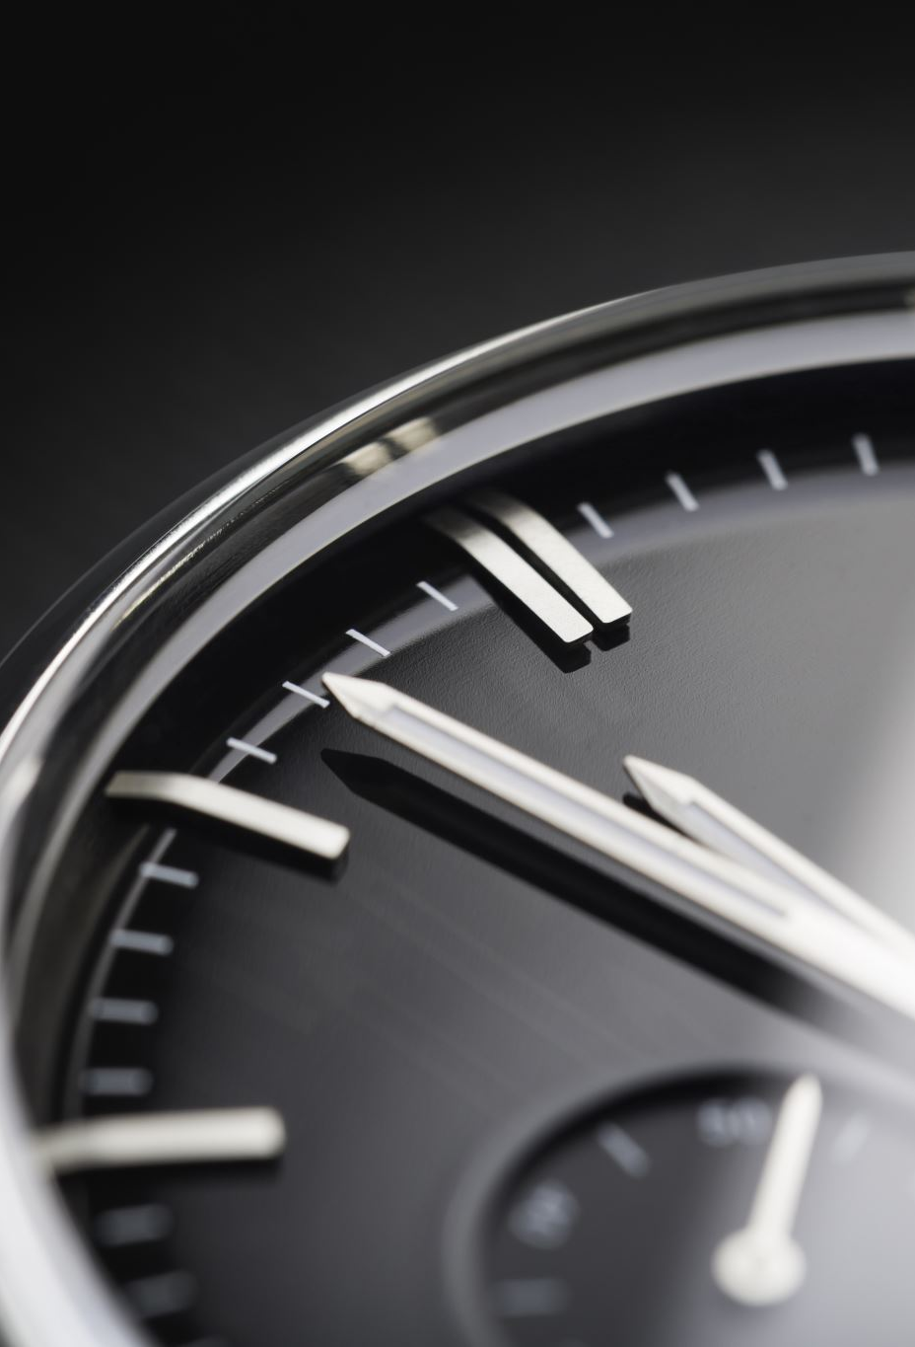
Additional Information
Water and air Temperature on the day of the swim.
  Water expected to be 57 – 60 Degrees F.
  Air expected to be 40 – 80 Degrees F.
The tide will be rising less than 1 foot during the swim.
  High at 1:10 AM and 1:56 PM
  Low at 7:52 AM

