Slide 1
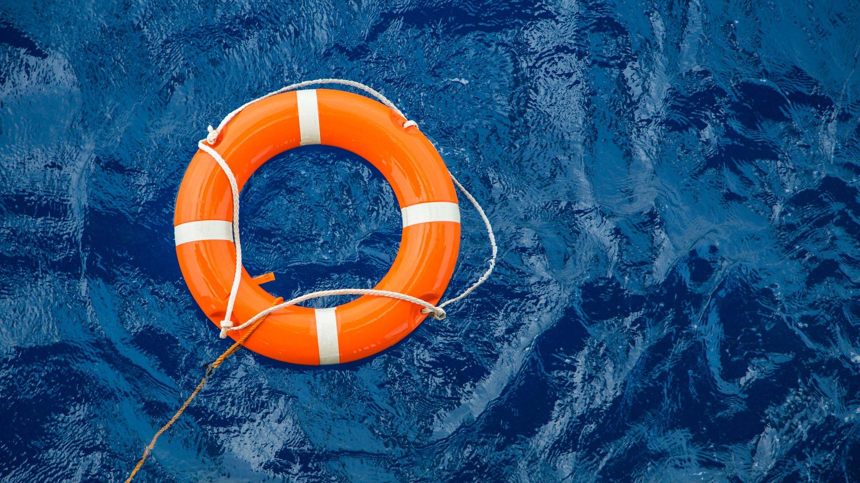
ANNAPOLIS FROGMAN SWIM Safety & Support Boat Briefing
Site: Chesapeake Bay in front of the Bay Ridge Community
Date: April 26, 2026
Benefit for the Navy SEAL Foundation

Slide 2
Support Boat/Jet Ski Personnel – List is made up of volunteers that have expressed their desire to volunteer again. It has not been finalized yet.
Name | Cell Phone # | Responsibility
Chris Sanders | 610-304-0046 | Jet ski with sled
Jim Foster | 443-994-9377 | Turn 1/Boat Captain
Kevin Cady | 619-602-9360 | Turn 1/Spotter
Ray Bogan | 908-675-2459 | Turn 2/Boat Captain
Jett Witte |  | Turn 2/Spotter
Justin Zimmer | 443-254-6600 | Zone 1 &2/Boat Captain
Gabi Redford | 410-279-3042 | Zone 1 & 2/Spotter
Mark Milleker | 443-956-0284 | Zone 3 & 4/Boat Captain/Support Boat-Jet Ski Director
Bill Shipp | 301-602-6341 | Zone 3&4/with Mark Milleker
Chris Swensen | 410-693-2500 | Beach
Frank Larkin | 443-852-2390 | Beach
David Sites | 301-674-4169 | Jet Ski with sled
Laura Buscher | 301-370-1688 | Jet Ski
Marc Fanelli | 240-372-2080 | Jet Ski with sled

Slide 3
Buoy and Volunteer Pick-Up
The Chesapeake Bay Foundation (CBF) dock will be used to pick up buoys and personnel.
The CBF dock is not to be used to dock boats.
The only boats allowed to dock for extended periods of time are the Fire-Rescue boats.

Slide 4
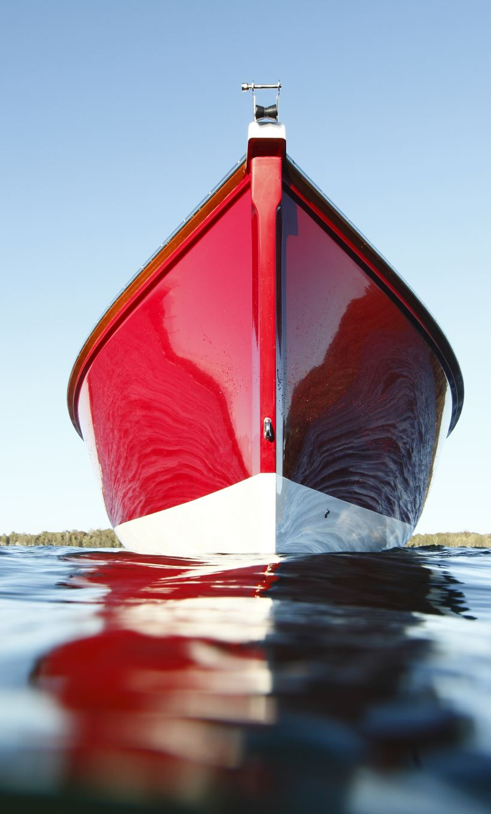
Safety First
Boats will be positioned at Turn Buoys and in a position to watch assigned zones on the course. Everyone should be at their designated spot by 8:00 AM.
Zone 1 and 2 –Justin Zimmer/Gabi Redford
Turn Buoy 1 – James Foster/Kevin Cady
Zone 3 and 4 –Mark Milleker/Bill Shipp
Turn Buoy 2 – Ray Bogan/Jett Witte
Turn Boats will record swimmer and kayaker number as they round the turn buoy. Kayakers have been instructed to yell out their numbers. Swimmer and kayaker numbers match.
Safety boats assigned to zones will watch for distressed swimmer or kayaker signal.
All boats will be anchored at their positions.
If you see a kayaker put up a distress signal or hear 3 whistle blasts, radio Fire-Rescue and let them know what zone to respond to. A jet skin in that zone with a sled will respond and the jet ski without the sled (Laura) will go to the fire boat to pick up a rescue swimmer.
Follow any instructions given by Fire-Rescue.

Slide 5
Radio Check Prior to the Swim
Support boats will monitor Channel 9 on the Walkie-Talkie and Channel 24 on VHF. Channels will be confirmed when the walkie talkies are handed out. The channels will also be posted on the Support Boat/Jet Ski GroupMe.
The Support Boat/Jet Ski GroupMe is only for Safety Boats, Jet Skis and Fire Rescue Personnel.
Communication Check will be at 8:20 AM by Frank Larkin, who will be with Chris Swensen at the start on the beach.
Safety Boats will have VHF Radio, Walkie-Talkie and cell phone.
A GroupMe chat group has been set up for communication on the cell phone in case the VHF and Walkie-Talkie does not work.

Slide 6
Jet Skis
Stay on outside perimeter of course.
Additional set of eyes to spot swimmers or kayakers in need of assistance.
Operators are trained to pick up swimmers. Will go onto course to pickup distressed swimmer and move them to Fire-Rescue boat for evaluation.
If a swimmer swims to them, the jet ski with the sled may take the swimmer to shore.
While going through the course, be mindful of swimmers on the course.

Slide 7
Know the Signals on the Course
Swimmer Off Course: One whistle blast by the kayaker to get the swimmer’s attention.
Distressed Swimmer or Kayaker: Paddle held up over head and three whisle blasts.
Swim Cancelled and Swimmers Return to Shore: Five short horn blasts followed by one long blast.
Kayakers will use a whistle to repeat signal
Swimmers will swim to the nearest shore.
Swimmers may swim to an anchored boat to get in, but support boats shall not turn motor on and collect swimmers.

Slide 8
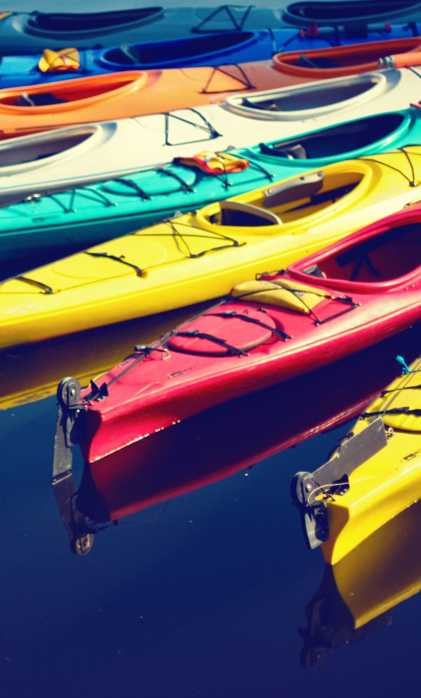
Course Set-Up
Set up will be coordinated by the Course/Safety Boat Manager.
At least 1 Boats will be assigned to pre-set-up the course on Friday or Saturday – Weather permitting.
Set the two Turn Buoys and guide buoys according to Latitude and Longitude Coordinates. (Chart given below)
Set up guide buoys in line with (Swim Direction is now clockwise)
Start to Turn 1 -3 round buoys (G1, G2, and G3)A1, A2 and A3)
Turn 1 to Turn 2 – 4 yellow cylinders (G4, G5, G6 and G7)
Turn 2 to Finish - 3 round buoys (G8, G9 and G10)

Slide 9
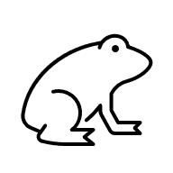
Primary Course Map with Zones
Z1
Z2
Z4
Z3

Slide 10
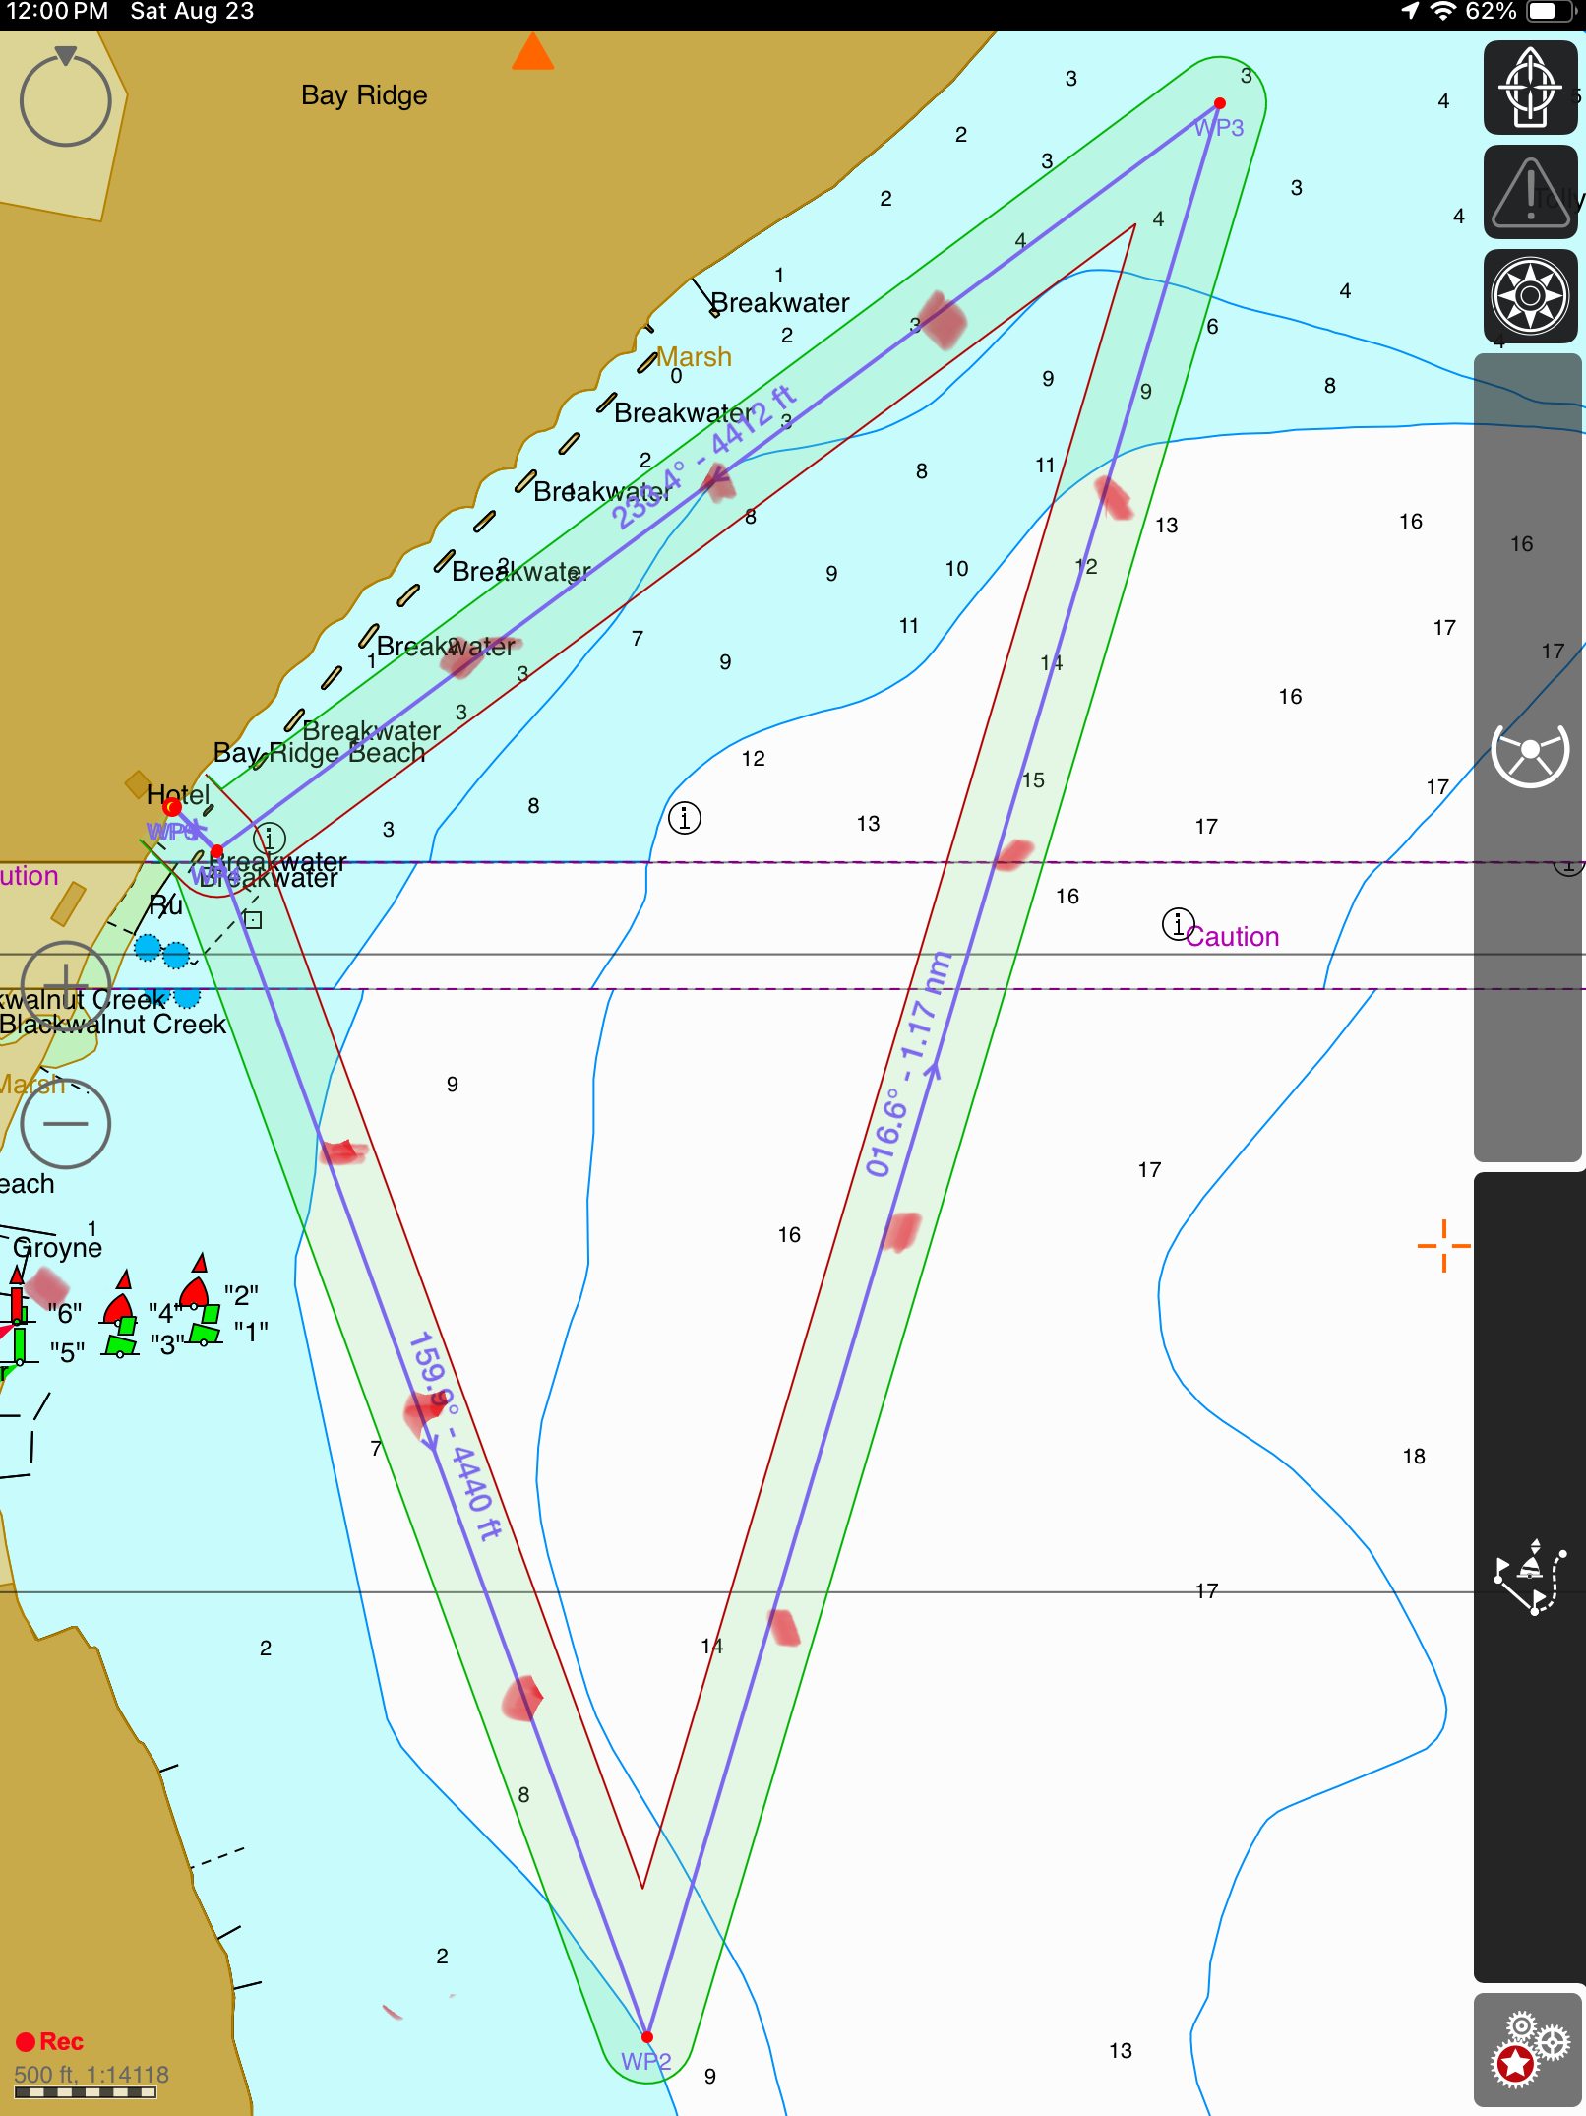
Primary course with guide buoys Turn Buoys: Tetrahedrons Guide Buoys on Leg 1 and Leg 3: Round Guide Buoys on Leg 2: Cylindrical
Turn 1
G3
G2
G4
Z-1
G1
Start/
Finish
Z-2
G5
G10
Z-4
Z-3
G6
G9
G8
G7
Guide buoys are labeled with a
G and may be passed on either
side. Turn buoys have to be rounded
to the outside of the course.
Turn 2

Slide 11
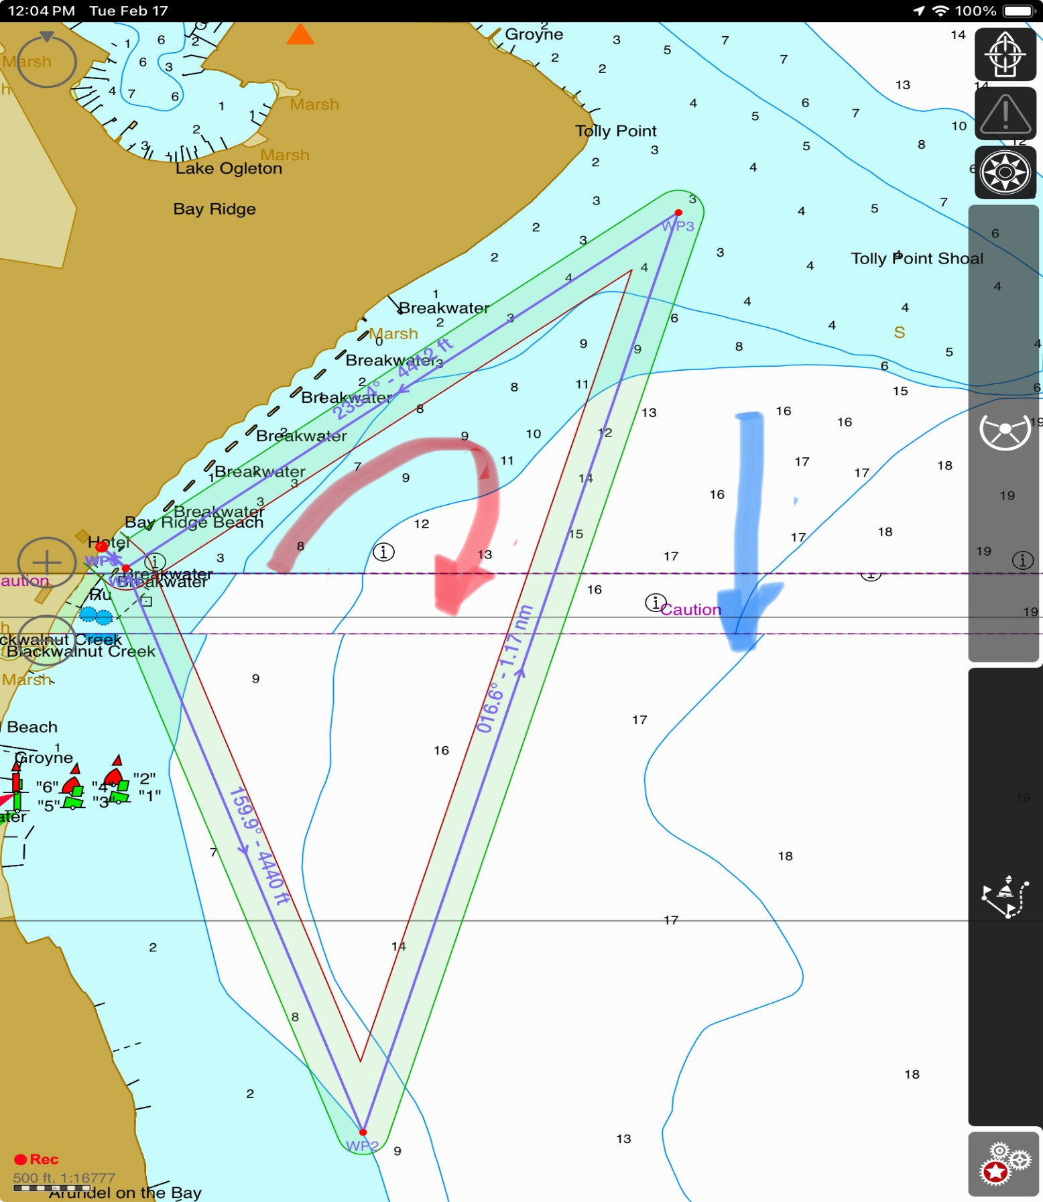
Course Swim Direction: Clockwise (Red Arrow) Current Direction: Left to Right (Blue Arrow)
Turn 1
G3
G2
G4
G1
Start/
Finish;
G5
G10
G6
G9
G8
G7
Turn 2

Slide 12
Annapolis Frogman Swim Course Buoy Locations
Buoy | Latitude (Degree-Minutes | Latitude (Degrees) | Longitude (Degree-Minutes) | Longitude (Degrees)
Start/Finish | 38 deg 55.934 min N | 38.9322 N | 076 Deg 27.651 Min W | 76.4609 W
G-1 | 38 56.044 N | 38.9341 N | 076 27.464 W | 76.4577 W
G-2 | 38 56.167 N | 38.9361 N | 076 27.245 W | 76.4541 W
G-3 | 38 56.260 N | 38.9377 N | 076 27.088 W | 76.4515 W
Bturn 1 | 38 deg 55.247 min N | 38.9208 N | 076 Deg 27.330 Min W | 76.4555 W
G-4 | 38 56.156 N | 38.9359 N | 076 26.982 W | 76.4497 W
G-5 | 38 55.968 N | 38.9328 N | 076 27.056 W | 76.4509 W
G-6 | 38 55.737 N | 38.9290 N | 076 27.146 W | 76.4524 W
G-7 | 38 55.472 N | 38.9245 N | 076 27.244 W | 76.4541 W
Turn 2 | 38 deg 56.368 min N | 38.9395 N | 076 Deg 26.903 Min W | 76.4484 W
G-8 | 38 55.438 M | 38.9240 | 076 27.418 W | 76.4570 W
G-9 | 38 55.610 N | 38.9263 N | 076 27.498 W | 76.4583 W
G-10 | 38 55.768 N | 38.9295 N | 076 27.569 W | 76.4595 W

Slide 13
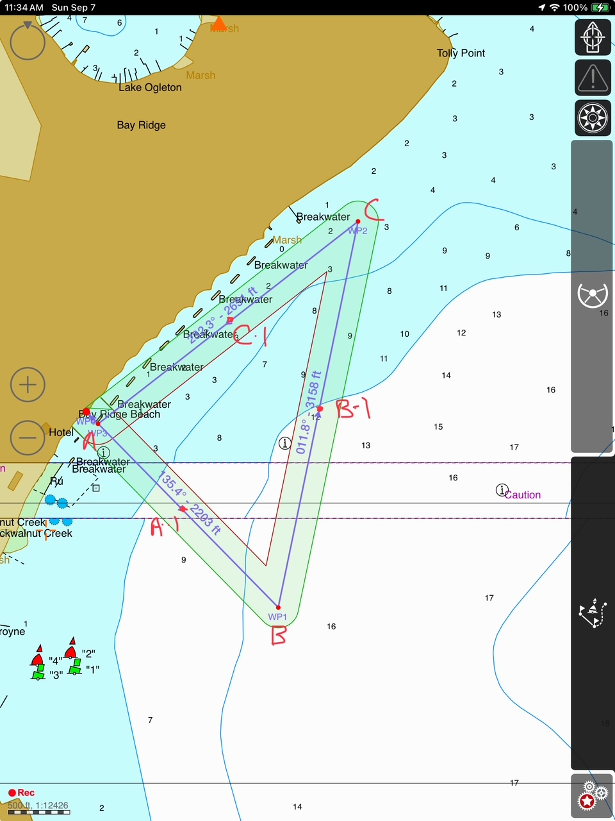
Annapolis Frogman 5K Swim/Alternate Course 1
Turn 1
Guide buoys are labeled with a
G and may be passed on either
side. Turn buoys have to be rounded
to the outside of the course.
G1
Start/
Finish
G2
To be used if weather from Northwest does not allow use of the primary course.
G3
Turn 2

Slide 14
Annapolis Frogman Swim Alternate Course 1 Coordinates
Buoy | Latitude (Degree-Minutes) | Longitude (Degree-Minutes) | Latitude (Degrees) | Longitude (Degrees)
A (Start/Finish) | 38 deg 55.992 min N | 076 deg 27.623 min W | 38.9332 N | 76.4604 W
G-1 | 38 56.103 N | 076 27.419 W | 38.9351 N | 76.4530 W
Turn 1 | 38 deg 56.247 min N | 076 min 27.179 min N | 38.9374 N | 76.4484 W
G-2 | 38 56.004 N | 076 27.240 W | 38.9334 N | 76.4552 W
Turn 2 | 38 deg 55.739 min N | 076 deg 27.314 min N | 38.9290 N | 76.4555 W
G-3 | 38 55.871 N | 076 27.481 W | 38.9312 N | 76.4580 W

Slide 15
Break Down – No Break Down will start until Safety on Shore (Chris & Frank) Gives Permission
After Safety gives permission to a specific boat or all boats after the swim, cleanup may start. Zone 1 cleanup will commence first. Leave the Freddie the Frog Buoys in for the finish.
Once the swimmers are past the mid-point of the second leg and have cleared Zone 2, the buoys in Zone 2 can be picked up if Safety has given permission.
Once the swimmers have cleared Turn 3, the buoys in Zone 3 can be picked up if Safety has given permission.
Buoys on the last leg can be collected once all swimmers have finished.
The boat watching Zone 4 must stay in place until all swimmers have finished.

