Slide 1


2027 Annapolis Frogman Swim to
Benefit The Navy SEAL Foundation
April 25, 2027
Event Plan
Location: Bay Ridge Pool Association-Community Beach
  2 Herndon Avenue, Annapolis, MD
Event Organizers
  Chris Swensen
    cwensen11@gmail.com
    410-693-2500
  David Priddy
    dpriddy57@gmail.com
    240-508-4629

Slide 2
Professionalism
The AFS is a physical challenge that can only be accomplished through coordinated teamwork and a spirit of shared responsibility for the safety of all participants.
At the AFS we pay pay homage to the best of the best that paid the ultimate sacrifice by matching their professionalism and tactical acumen with like professionalism and tactical acumen.
Two critical principles for a successful and safe AFS:
  This is a Team Event.
  Accountability is mandatory.

Slide 3
Preparation
First: The Team consists of one swimmer and one safety kayaker operating as a cohesive unit. We ask that each Team think and function in a manner that honors those we represent during the swim and kayak.
A cohesive Team operates, navigates and communicates effectively in all conditions. To be effective requires a degree of rigor and discipline. The entirety of the AFS Event Organizers and Volunteers requests that each swimmer/kayaker Team take the time to develop an individual Team plan.
Swimming in the Chesapeake Bay in April is a significant challenge for swimmers and kayakers of all levels. Please know and respect the swim area dynamics (tides, current, wind, waves, water temperature, floating debris) and know the swim course buoy markers.

Slide 4
Accountability
Accountability is non-negotiable and we ask your support for everyone’s safety and a successful AFS. Please read and understand this ‘Event Plan’, and two Briefings found on the AFS website:
  Swimmer and Kayaker Safety Briefing
  Safety Boat & Jet Ski Briefing
Please read and understand the Start, Finish and rounding Turn Buoys procedures.
Swimmers are chipped and manually counted in at the start and out at the finish. Kayakers are manually counted in at the start and out at the finish.
Know distress signals and procedures to get on water assistance.
We ask that each swimmer and each kayaker commit to ensuring their Team’s accountability and follow all procedures during the event.

Slide 5
Dates to Remember
Disclaimer
Registration Opens: November 11, 2026
Swimmer and Kayaker Check-In: April 24 and 25, 2027
Event Swim Date: April 25, 2027
  Check website (www.annapolisfrogman.com) for updates
  Times are subject to change based on weather conditions. Check website starting on Friday, April 23, 2027
  There is no alternate date. If event is cancelled due to weather the Pre-Swim Ceremony and After Party will still take place starting around 10:15 AM.
This Event Plan Summary does not include all of the safety protocols for the event. Each swimmer and kayaker is responsible to read the Swimmer and Kayaker Safety Briefing, which includes information on hyperthermia, distress signals, and protocol that needs to be followed in the event of a distressed swimmer or kayaker or changes made due to weather. Safety and Support boats and jet skis are also required to read the Safety Boat & Jet Ski Briefing.

Slide 6
Event Site
Open Water Event in the Chesapeake Bay
Swim starts and finishes off the beach in front of the Bay Ridge Community Pool
The course is marked by buoys as described in the event notes
Support craft include kayakers, jet skis, small motorboats, and Fire Dept. Search and Rescue Crafts
Land Facility includes:
  Parking (Please carpool)
  Bathrooms & Showers
  Warming Tent on the beach
  Clubhouse
    After party will be hosted upstairs
    Seating for all swimmers, kayakers, volunteers and Gold Star Families only.

Slide 7
Swim Plan
5 K Open Water Swim
  Cold Water Swim (55-60℉)
  Wetsuits required unless approved in writing by Event Organizers. Fins are allowed
  All swimmers must have a kayak escort. Personal swim buoys are allowed and encouraged
Swim preceded by:
  Ceremonial Events Honoring Navy SEALs and Special Warfare Combatants who died in action or training and Gold Star Families.
  Safety Briefing, Course Briefing and Weather/Water Conditions Update
Motorboats will be anchored at the turn marks or inside the course to observe swimmers. Motorboats will not approach swimmers, but swimmers can swim to the anchored boat, or a jet ski may bring a swimmer to the boat.
Jet Skis may go inside the course and around swimmers to pick up a swimmer in distress. May have a sled for the swimmer to climb on and be towed to a Fire Dept. boat for evaluation and then to shore or to an anchored boat if necessary.
Kayaks and Paddleboards
  Swimmers escort
  Roving kayaks to observe swimmers and other kayaks and to replace another kayaker if necessary

Slide 8
Event Notes
On the Beach – Swimmer Area
  Starting Corral for each Wave of Swimmers to Enter Before Their Start
  Swimmers Need to Wear Timing Chip When Entering the Corral
  Swimmers Need to Hand In Swim Ticket (Wooden Tongue Blade with their number on it) when entering Corral
  Once in the Corral the Swimmer cannot Leave
On the Water
  Primary course: Triangular – Know the course beforehand.
  Each Turn has a Large Tetrahedron Buoy
  Additional buoys are lined up on the course to guide kayakers and swimmers
  Guide buoys will be Cylindrical and Round. “Freddie the Frog” buoys will mark the Start/Finish turn.
On the Beach – Kayak Area
  Kayaks are tagged for wave and swimmer number before being brought down to the beach
  Kayaks leave from separate area on beach
  Kayaks are lined up on beach according to Waves

Slide 9
Event Rules
Wetsuits required unless approved in writing by Event Organizers. Fins are allowed
If the swimmer appears in distress and the Fire/Rescue Personnel tell them to get out of the water, they must get out of the water and follow any directions given
All swimmers must provide and register a support kayaker. Swimmer must be paired with a kayaker to start
Swimmers must hand in “swim stick” and wear timing chip when entering the Start Corral. Once the swimmer is in the corral, they may not leave it until after the start. If they decide not to swim they must see the corral organizer before exiting the corral.
Swimmers and Kayakers will have the swimmer’s number marked on their hands. Kayakers will have the Swimmer number pinned to their back and not covered by their PFD.
Swimmers and Kayakers must register an Emergency Contact Name and Number for the day of the event
No refunds for event/swim cancellation.
Only Swimmers, Kayakers, Start/Finish Personnel and Designated Event Officials. Volunteers and Gold Star Families are allowed on the beach between 8 AM and 11:45 AM
Swimmers and kayakers with disabilities must notify the Event Organizers in writing by March 26, 2027 of any special needs. The Event Organizers can decline participation and suggest a volunteer role.
The Annapolis Frogman Swim is “more than just a swim”. Most swimmers fundraise more than the goal of $2000.

Slide 10
Event Rules (continued)
11. Swimmers and kayakers arriving late after the last Wave has started will not be allowed to swim.
All timing bands must be returned once the swimmer finishes the swim
Once the swimmer has completed the swim, they will be led to the Warming Tent and evaluated before they are allowed to leave. If there are any lingering effects from the cold, they must follow the directions of the Event volunteers and/or paramedics.

Slide 11
Contingency Plan
No make-up date due to weather cancellation. No refunds.
If conditions warrant, we may change the Swim Course for safety reasons. An alternative Swim Course is attached for use if the Swim Course is changed prior to the start
If weather conditions worsen during the swim, the course may be shortened
If the swim is abandoned after the start, it will not be restarted
If a Turn Buoy breaks loose, a roving kayaker may position himself as the turn until the Turn Buoy can be resecured
Read the Swimmer and Kayaker Safety Briefing to become familiar with all visual and sound notifications that may be made on the course

Slide 12
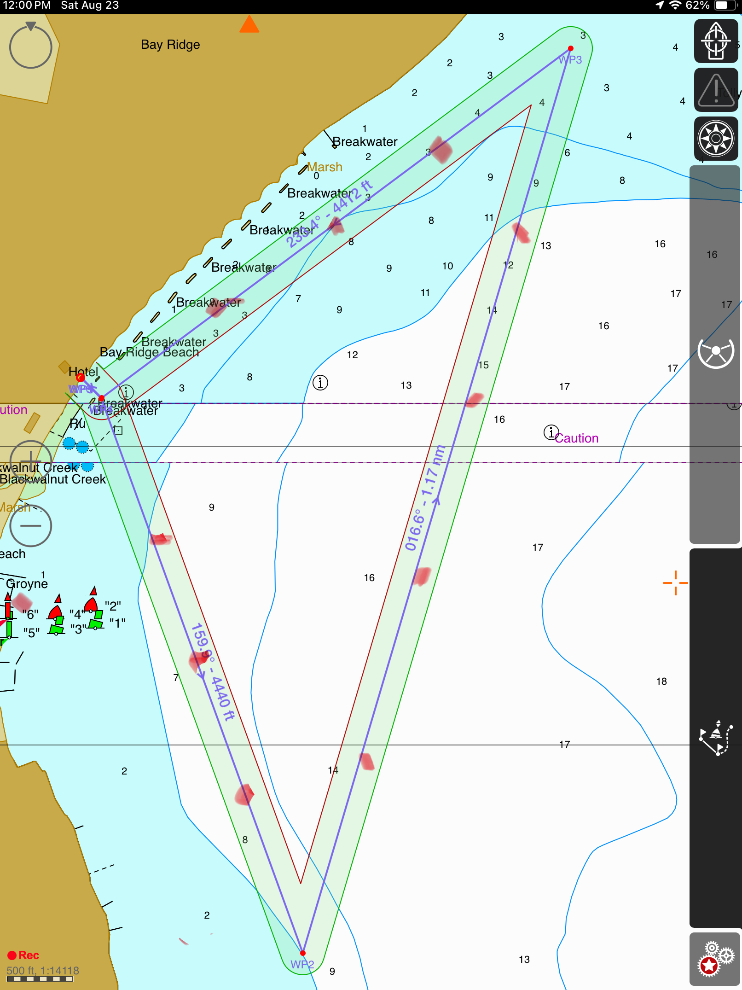
Primary course with guide buoys
Turn Buoys: Tetrahedrons
Guide Buoys on Leg 1 and Leg 3: Round
Guide Buoys on Leg 2: Cylindrical
Turn 1
G3
JS = Jet Ski
JS-R – Roams with the FD
JS-r will pick up Rescue
swimmer if needed.
JS-1 will start in Zone 1 and
move to Zone 4 once
Zone 1 is clear.
All Jet Skis remain on outside
parimeter unless a swimmer
is in distress.
JS-1
G2
G4
Z-1
JS-2
G1
Start/
Finish
Z-2
G5
JS-R
G10
Z-4
Z-3
G6
G9
JS-1
JS-3
G8
G7
Guide buoys are labeled with a
G and may be passed on either
side. Turn buoys have to be rounded
to the outside of the course.
Turn 2

Slide 13
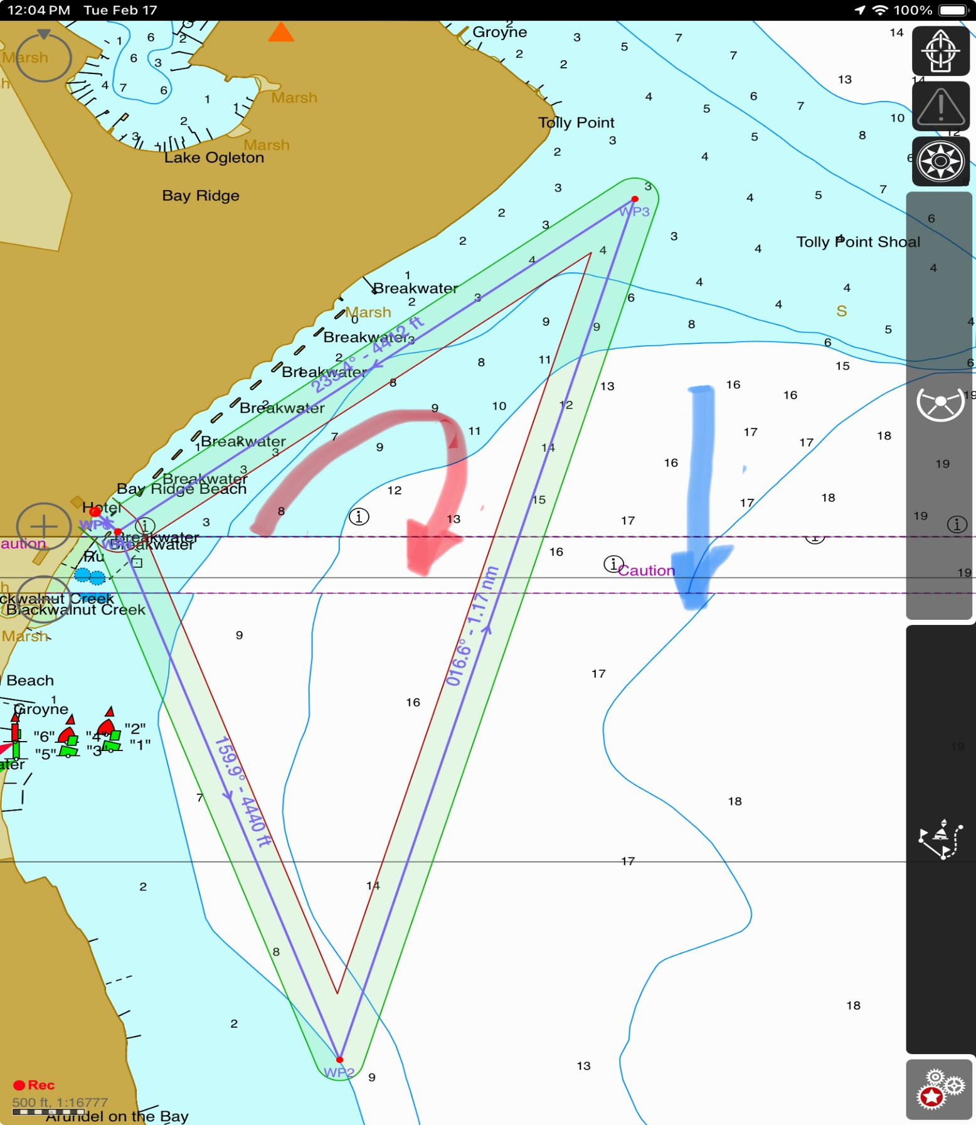
Primary Swim Course Swim Direction: Clockwise (Red Arrow)
Current Direction: Left to Right (Blue Arrow)
Turn
Buoy 1
Start/Finish
Turn
Buoy 1

Slide 14
Annapolis Frogman Swim Primary Swim Course Buoy Locations
Buoy | Latitude (Degree-Minutes | Latitude (Degrees) | Longitude (Degree-Minutes) | Longitude (Degrees)
A | 38 deg 55.934 min N | 38.9322 N | 076 Deg 27.651 Min W | 76.4609 W
A-1 | 38 55.768 N | 38.9295 N | 076 27.569 W | 76.4595 W
A-2 | 38 55.610 N | 38.9263 N | 076 27.498 W | 76.4583 W
A-3 | 38 55.438 M | 38.9240 | 076 27.418 W | 76.4570 W
B | 38 deg 55.247 min N | 38.9208 N | 076 Deg 27.330 Min W | 76.4555 W
B-1 | 38 55.472 N | 38.9245 N | 076 27.244 W | 76.4541 W
B-2 | 38 55.737 N | 38.9290 N | 076 27.146 W | 76.4524 W
B-3 | 38 55.968 N | 38.9328 N | 076 27.056 W | 76.4509 W
B-4 | 38 56.156 N | 38.9359 N | 076 26.982 W | 76.4497 W
C | 38 deg 56.368 min N | 38.9395 N | 076 Deg 26.903 Min W | 76.4484 W
C-1 | 38 56.260 N | 38.9377 N | 076 27.088 W | 76.4515 W
C-2 | 38 56.167 N | 38.9361 N | 076 27.245 W | 76.4541 W
C-3 | 38 56.044 N | 38.9341 N | 076 27.464 W | 76.4577 W

Slide 15
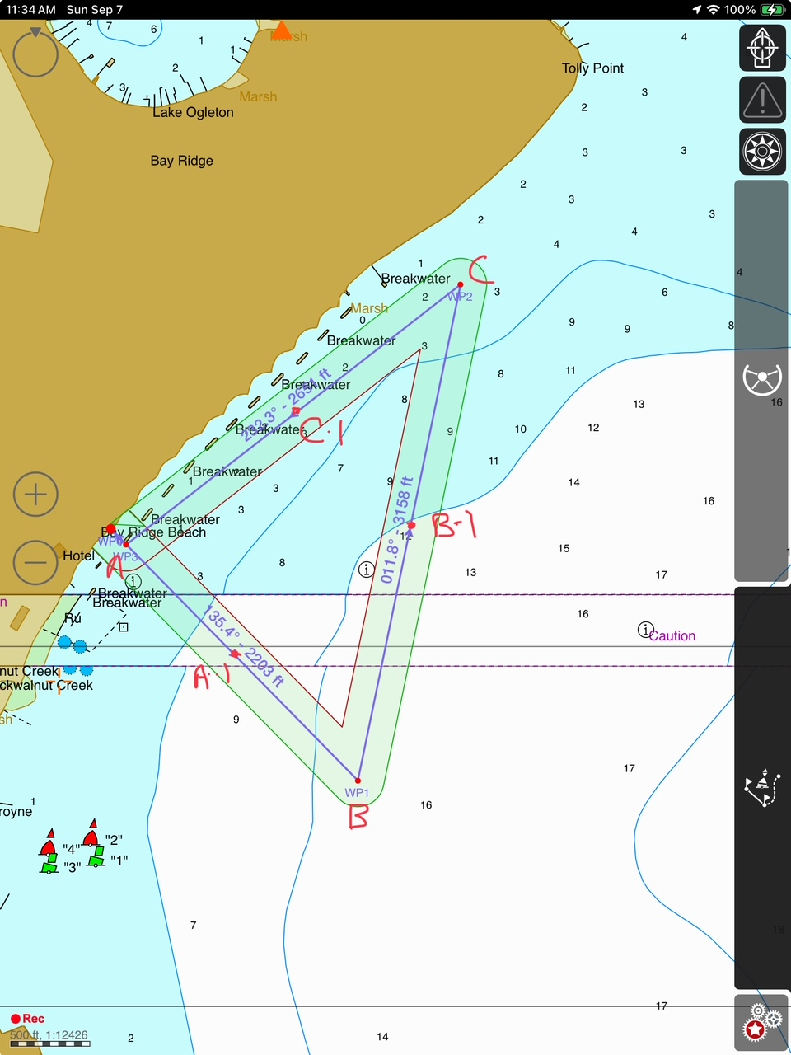
Annapolis Frogman Swim Alternate Course
To be used if weather from Northwest does not allow use of the primary course.
Turn Buoys: Large Tetrahedrons
Guide Buoys: Cylinder and Round buoys – smaller than turn buoys
Turn
Buoy 1
Start/Finish
Turn
Buoy2

Slide 16
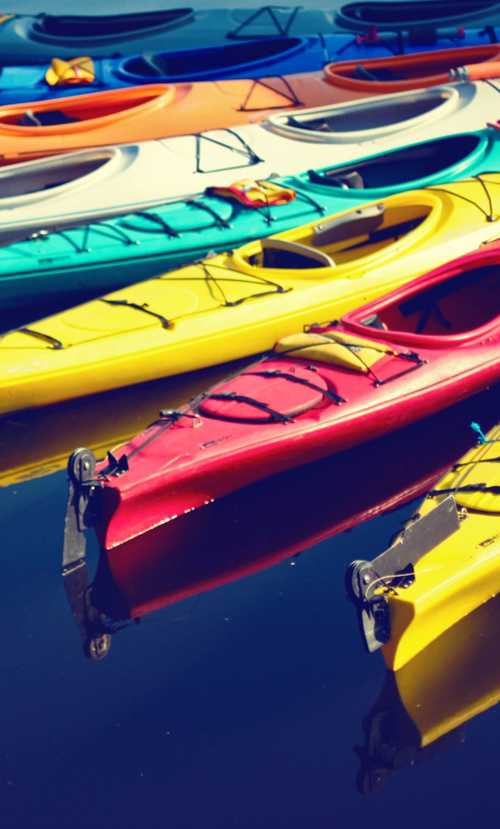
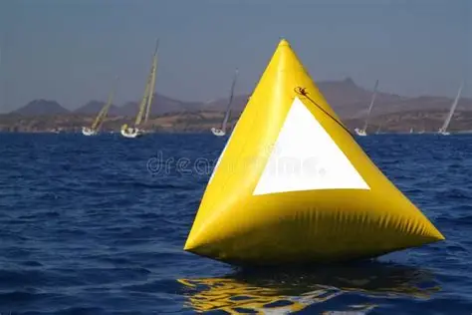
Tetrahedron Turn Buoy

Slide 17
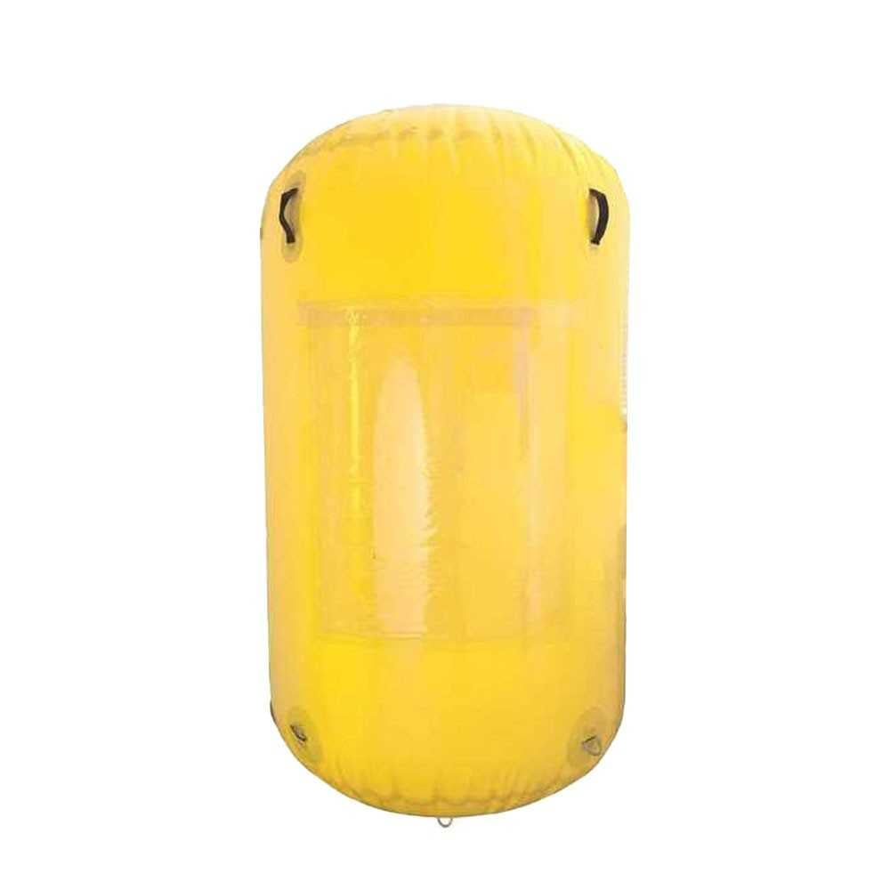
Cylindrical Guide Buoy

Slide 18
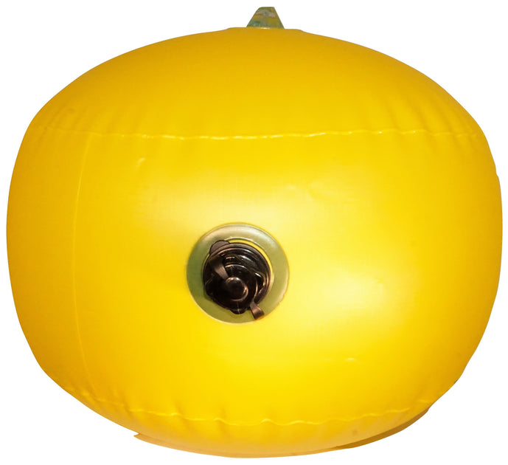
Round Guide Buoy

Slide 19
Annapolis Frogman Swim Alternate Swim Course Coordinates
Buoy | Latitude (Degree-Minutes) | Longitude (Degree-Minutes) | Latitude (Degrees) | Longitude (Degrees)
A | 38 deg 55.992 min N | 076 deg 27.623 min W | 38.9332 N | 76.4604 W
A-1 | 38 55.871 N | 076 27.481 W | 38.9312 N | 76.4580 W
B | 38 deg 55.739 min N | 076 deg 27.314 min N | 38.9290 N | 76.4555 W
B-1 | 38 56.004 N | 076 27.240 W | 38.9334 N | 76.4552 W
C | 38 deg 56.247 min N | 076 min 27.179 min N | 38.9374 N | 76.4484 W
C-1 | 38 56.103 N | 076 27.419 W | 38.9351 N | 76.4530 W

